Slide 1
Brittingham Memorial Library Strategic Planning May 25, 2021

Slide 2


Executive Summary
Guiding Statement: The Brittingham Memorial Library’s physical space of the future should be an educational space with technology and built into the MetroHealth community on the W. 25th campus.
Challenge: The physical footprint of MetroHealth’s W. 25th campus is changing – resulting in the need for many spatial and operational changes across clinical and administrative spaces.
Stakeholders within MHS identified key areas where the Library provides organizational value –notably in providing high-value research support and a space for individual and group work.
The footprint of the library will change as the W. 25th campus transforms. The new library will be noncontiguous, with some space in a high-traffic area and additional space for administrative use in the basement of Rammelkamp.
Goal is to provide maximum value, with limited space. The library will achieve this by 1) growing awareness & reach, 2) evolving virtual operations, and 3) augmenting with high value research support.

Slide 3
Supportive Strategies
Transform physical presence at MetroHealth W. 25th campus
Grow awareness & reach
Each strategic recommendation supports the other recommendations. The successful implementation of any recommendation reinforces the other recommendations.
Augment with high-value research support
Evolve virtual operations

Slide 4
Transform physical presence at MetroHealth W. 25th campus
Transform physical presence
Transform Physical Presence
Challenge: W. 25th campus is transforming and as a result the contiguous footprint of the library will change.
Key Insights:
Improved virtual resources are preferred to improvements in physical space
Space for people is preferred to space for “stuff”
Individual study areas and group meeting areas are top priorities for users
Supports evolving virtual operations by 1) enhancing electronic resources, and 2) empowering employees to use self-service options
Supports augmentation with high-value research support by evolving to a virtual partner offering concierge services.

Slide 5
Grow awareness & reach
Grow awareness & reach
Grow awareness & reach
Challenge: Many MHS employees do not know about the BML, and / or do not know what services / resources the library provides
Key opportunities:
Present at large meetings
Inclusion in orientation materials
Mini-educational sessions
Clear and concise list of what is accessible to employees, where it can be accessed, and how to log-in (if needed)
Support from marketing team (Internal or external)
Supports evolving virtual operations by 1) improving knowledge of electronic resources, and 2) creating additional opportunity for collaboration within MHS.
Supports augmentation with high-value research support by becoming a known educational resource for the system at large.

Slide 6
Evolve Virtual Operations
Evolve virtual operations
Evolve Virtual Operations
Challenge: Current interface is frustrating and not user friendly. Employees desire a self-service option for rapid access to information.
Key insights:
Employees prefer improved electronic resources to access to physical space
There is system-wide poor knowledge of electronic resources the library provides
Self-service ability is strongly desired
Collaboration opportunity both internally and externally
Supports physical transformation by improving virtual access and thus limiting need for physical space.
Supports growing awareness and reach by informing employees what resources fall under the library umbrella.
Supports augmentation with high-value research support by becoming a virtual partner to users throughout the system.

Slide 7
Augment with high-value research support
Augment with high-value research support
Augment with high-value research support
Challenge: Insufficient staff to support expanded literature searches and educational initiatives, which users have indicated they highly value.
Key opportunities:
Users want the library to be an educational resource for the system
Ideal state would be the library as a concierge service
Become a virtual partner for the system
Hire additional staff to support
Supports physical transformation by improving virtual access and thus limiting need for physical space.
Supports growing awareness and reach by providing additional library staff to present at large group meetings and conduct more literature searches.
Supports evolving virtual operations by providing more robust virtual resources.

Slide 8
Findings & Insight

Slide 9
Survey responses
Noise level
Comfortable seating
Adequate signage
Improved virtual resources are preferred to improved physical space
Findings & Insight – Physical Space Recommendations
Executive Summary
Critical components of physical space, by response format.
Computer availability
People space is more important than stuff space
Individual study areas
Meeting/group work areas
Strategic Retreat*
Office space for 3+ staff
Lounge space
Rare book room
Exhibit space
Location in high-traffic area
Educational center
Storage area
Interview Reponses
Resident space
Modernize
*Findings from the strategic retreat provided a different lens than interviews and surveys

Slide 10
Findings & Insight – Augment with High Value Research Support
Survey responses and interviews indicated that high value is achieved when interacting with library staff.
Survey
Interviews
Strategic Retreat
Employees indicated that literature searches were the service they are most aware of and use most frequently.
57% of survey respondents indicated they were aware the library supported literature searches and 42% have used library resources to support literature searches.
“Laura and Terri are very helpful especially with article searches.”
Satisfied with current support for literature searches but unaware of many library services
See the future library as an educational institution for the system
“I see for the future of [the library] as not only a facilitator for research but also an educator (…) on research materials but also other products like Outlook, Excel, PowerPoint, etcetera.”
“I don’t think we need a library – we need librarians. Why do we need to own books? We need more access and someone to help us, guide us to the right resources and navigate how to get them.”
“Primary and highest value is personal service – concierge services.”
“You need a virtual partner to navigate your research needs.”

Slide 11
Findings & Insight – Grow Awareness & Reach
Survey clearly identified awareness as a barrier to success of the library; 11% (38 respondents) of respondents indicated they were either unaware of or did not use any library resources.
Strategic Retreat*
Invite staff to have meetings in the library space
Improved signage**
New marketing board committee
Cafeteria “windows” PR
Library for patients / the public
Connecting with other MH events
Super user education
Annual reports
Inclusion with other MH publicity**
Lecture series
Tie in with MH history / archives
Liaison among key constituents / consumers
Printed items / giveaways
Library brochure
Library for HS students**
30 second PSA video about library
Book sales /signings
Evolve from membership model
Work with marketing team
Newsletter/email blast
Open house / online virtual tour
Extend beyond library and integrate with clinical realm**
Branding
** Indicates strategic retreat ideas that directly conflict with voices from interviews / surveys.
Signage – Only 4 survey respondents indicated that adequate signage was important to them in the library when prompted.
Library for patients / HS students – Interviewees found this to be an intriguing idea but did not feel it was of highest value to system.
Integration with clinical realm – Interviewees indicated a preference for literature search support over a clinical librarian.
Interviews
Mini-educational sessions
Listing all materials available & where to find / how to login
Present at large meetings
Inclusion in orientation
Marketing campaign
*Findings from the strategic retreat provided a different lens than interviews and surveys

Slide 12
Findings & Insight – Evolve Virtual Operations
Survey
Interviews
Strategic Retreat
Employees indicated a preference for improved access to electronic resources over access to physical space
Majority of respondents (54%) had never been to the library MIV page, indicating poor awareness of virtual resources
Library subscribes to some resources that are not used (i.e., SydneyPlus Online)
Strong desire for self service availability
Employees get frustrated when they try to access journals themselves because the website is not user-friendly, there are too many steps, and the search function is not intuitive
Website should help people get to information quickly
Collaborate with CWRU/CPL
Enable platform for online donations
Evolve MIV real estate
Advanced website design
Live chat with librarian feature
Synergies with other departments (i.e., SIM center)
Add additional online resources

Slide 13
Appendix

Slide 14
Brittingham Memorial Library Strategic Planning March 3, 2021

Slide 15
Brittingham Library – Key Findings from Interviews and Survey
Value is achieved when users interact for assistance but are frustrated by self-service options.
Experiences with the library are positive, but awareness of existence, purpose and services is low.
People agree that another librarian would be helpful for more literature searches and staff education but do not see significant benefit of a rounding librarian.
Everyone agrees the library provides an invaluable service, but opinions/preferences of physical space vary based on role in the system.
The library is viewed as a place for doctors but there may be an opportunity to expand services to include others in the stakeholder groups.

Slide 16
SWOT Analysis: Brittingham Memorial Library
S
W
Strengths
Weaknesses
Literature Searches – Literature searches were the most personally used services as indicated by survey respondents, and survey respondents indicated a high degree of satisfaction with literature searches.
Helpful Staff – Survey respondents and interviewees indicated high satisfaction with library staff and speed at which materials were received.
Awareness – Survey indicates that between 8-12% of respondents were not aware of the library. 54% of respondents have not accessed the library webpage on the MIV and 24% of respondents have not been to the physical space.
O
T
Changing Habits– As traditional access to information changes, the historic operations of the library need to keep pace enabling MH constituents anywhere to benefit.
Campus Transformation – As MetroHealth’s main campus transforms and reduces the physical footprint on W. 25th street, Brittingham Memorial Library will be needed to reimagine how to fulfill customer needs.
Marketing – 54% of respondents indicated that the Brittingham Library would improve services by advertising / making employees aware of services. 42% of respondents indicated that if they could make a change to improve the Brittingham Library it would be to advertise / make employees aware of services.
Improved Self-Service Options – Interviewees indicated significant frustration when trying to find articles on their own. There is a significant opportunity to streamline Brittingham Library resources so that MetroHealth employees can find articles on their own.
Threats
Opportunities

Slide 17

Brittingham Strategic planning efforts aligned with System Strategy
The Brittingham Memorial Library will support the evolution and enhancement of training & research at MetroHealth.
9
CONFIDENTIAL PROPRIETARY TRADE SECRET / PROPERTY OF THE METROHEALTH SYSTEM / DO NOT DISTRIBUTE

Slide 18
Brittingham Library – Strategic Themes
Transform for Future to support the needs of constituents across an increasingly geographically distributed system, transition to a virtual library service
Improve self-serve operations to enable online access to allow employees to better serve themselves.
Build Awareness and grow constituents through internal communications campaign for multiple audiences.
Improve educational support by expanding the personal research resources Hire additional librarian for support with education and literature searches.

Slide 19
Draft Strategic Plan for Brittingham Memorial Library
5 year Strategic Goal: In concert with the transformation of The MetroHealth System, the Brittingham Memorial Library will evolve to ensure continued high value support to all clinical staff and learners.
Evolve Virtual Operations
Exploration of best practices, and collaborations with SOM to create a user-friendly self service virtual library of the future
Augment with High Value Research Support
Expand personal research resources
Grow Awareness and Reach
Enable more of the MetroHealth system to understand, use and value the research support
2021 - 2025

Slide 20
Survey Methodology & Responses

Slide 21
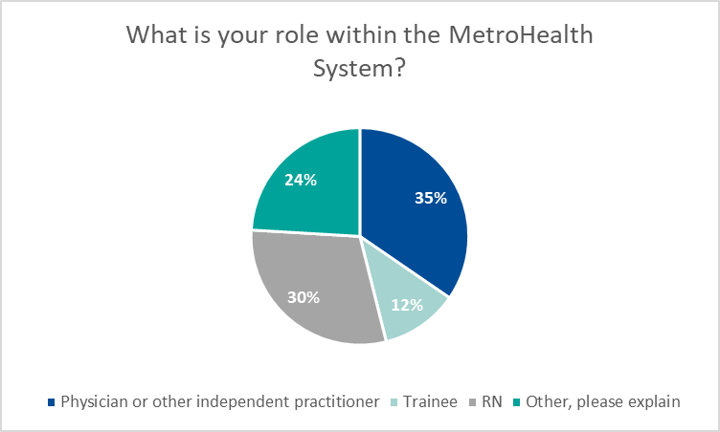
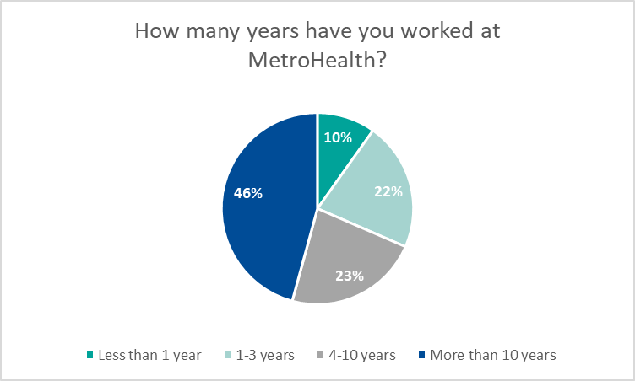
Survey Responses - Respondents
Survey was posted to the MIV and highlighted in a MIV story
Specific job roles were targeted (email blasts to RNs, residents, and research)
342 total responses
Most represented departments: Internal Medicine, Med Peds, ED, Nursing, OBGYN, Pathology, and PM&R
Most represented “Other”:
Researcher
Administration
Paramedic/MTA

Slide 22
Survey Responses – Library Use
Survey respondents were more likely have been to the library than to have visited the library MIV page
342 people responded to question 1, regarding physically visiting the library
340 people responded to question 2, regarding accessing the library MIV page

Slide 23
Survey Responses – Library Use, Services
Responses indicate that literature searches are the service of which people are most aware and most likely to use.
Interlibrary loans are the second most known and used services that the library offers.
Almost 11% of respondents indicated that they were either unaware of the library entirely or did not use any library services.

Slide 24
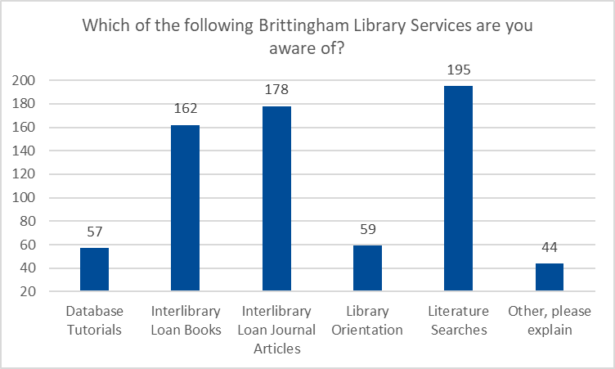
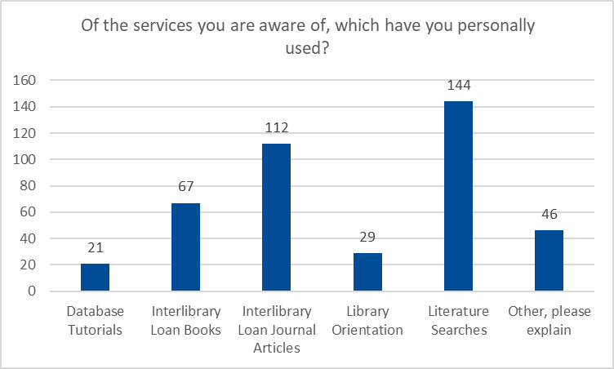
Survey Responses – Library Use, Services
N = 286
Most represented “Other”:
None / I was not aware of the library (23)
Physical space (13)
Book Loan (CPR, BLS, AHA, ACLS) (6)
N = 245
Most represented “Other”:
None / I was not aware of the library (26)
Physical space (10)
Book Loan (CPR, BLS, AHA, ACLS) (6)

Slide 25
Survey Responses – Library Use, Resources
Awareness of CINAHL, Ovid, journals (both print and electronic), UpToDate, and PubMed was high among respondents.
Most used resources are UpToDate (71% of respondents), PubMed (71% of respondents), and Electronic Journals (61% of respondents)
Almost 11% of respondents indicated that they were either unaware of the library entirely or did not use any library services.

Slide 26
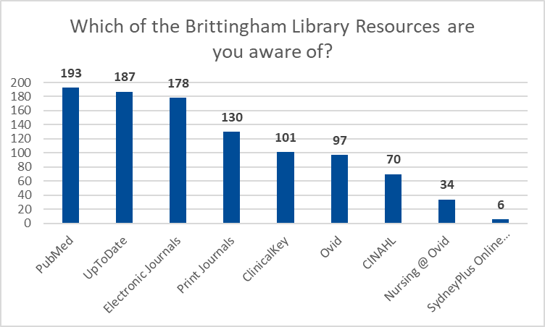
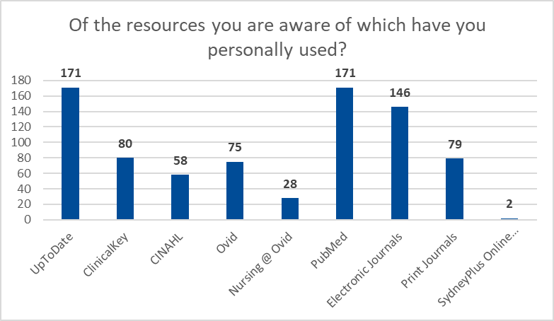
Survey Responses – Library Use, Resources
N = 263
N = 240

Slide 27
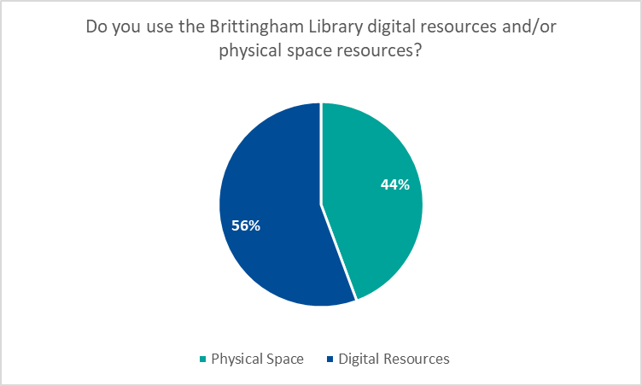
Survey Responses – Physical Space
What is valued in physical space
N = 327
Data suggests that what people are looking for in the physical space is a quiet area to complete individual work
Of respondents who answered “other,” 16 indicated “None / I was not aware of the library”
N = 285

Slide 28
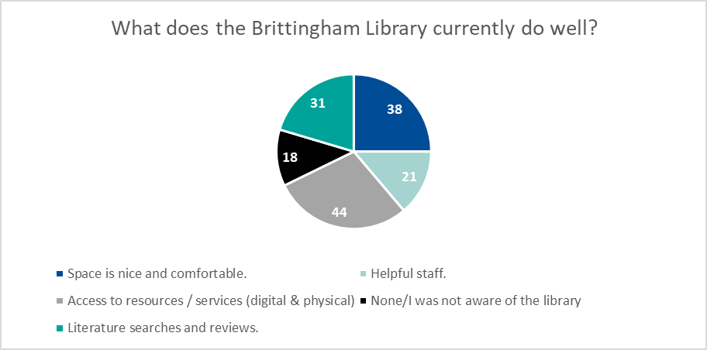
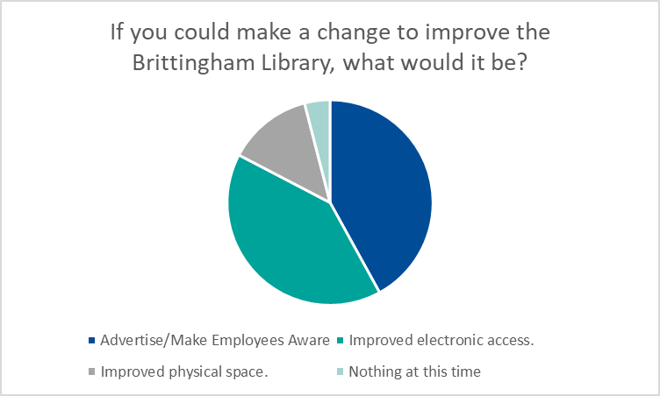
Survey Responses – Areas for Improvement
Respondents strongly indicated that advertisement / employee awareness of library is essential to improvement (54%)
Employees indicated preference for improved access to electronic resources over access to physical space.
N = 152
N =150

Slide 29
Theme 3: Build awareness & grow constituents.
“To this moment I have received zero orientation to those resources [Clinical Key and UpToDate]. I have no idea what is in them. If you want to know where to start… start with this, orientation needs to be reviewed. How would anyone know what is there if they have never been shown?”
“The librarian knows so many tips and tricks that we don’t know so it’s so great to have her for that.”
It would be great to have mini educational sessions. Just 30 minute sessions maybe monthly or something and you could do recorded or live WebEx on different things that the library offers or has available. The library has a wealth of knowledge that we probably don’t even know how to start taking advantage of.
“Present at large meetings (e.g. Nursing Shared Governance General session, Nurse Educators and Knowledge & Innovation subcommittees) to ensure folks are aware and utilizing this wonderful resource.”
“I wish there was more publicity. I’m sure Laura is so busy during the day but there needs to be more advertising for the library. A lot of people don’t know about it. Literature advocacy, evidence-based practice, that type of thing is the value our library can provide.”
“It would be good if we could get a listing of all the journals and periodicals that the library subscribes to.”
“This may be silly but is the library site separate from the clinical key site?”
“Nobody talks about the library but everyone uses Up-To-Date so the library should market that.”
“I would start with a campaign for what is available. We have a lot of new staff and people aren't just sitting around watching the MIV so a campaign that tells people what is available would be good.”

Slide 30
Theme 3: Build awareness & grow constituents.
“I don’t know anything about the library, besides where it is.”
“I am doing a presentation in a few weeks and working with someone from Johns Hopkins and she was using a medical librarian to do a literature search which I didn’t even think to do. It would be great if that were something our librarians could do.”
“Occasionally I will send an electronic request. My experience was fine. It was something I suspect most of the faculty in my department do not know is available to them. Some of it is just getting the word out about what resources are available.”

Slide 31
Theme 4: Improve educational support by expanding the personal research resources
“Mostly I need help with things like Zoom, WebEx, and Excel. I would love to take classes on this and I think the library should host.”
“Lessons on how to do a PubMed search or something would be helpful. Physicians would benefit more if the librarians taught more.”
“I’m oftentimes stuck when we’re rounding or discussing a case and a question comes up and there is a relative inability to use a smartphone to get an answer. There is obviously a curricular need too.”
“The librarian is really helpful with searches or doing a search for me… always really responsive.”
“It’s an interesting idea to have a more clinically minded librarian.”
“I wish we had more Laura Fraters”
“I would be more inclined to send our staff nurses to the librarian if there were more librarians.”
“I'd like to see them do some workshops maybe in conjunction with LEAP for the Microsoft suite.”
“Having librarian support to get through IRB or to find articles or to help brainstorm research would be really helpful.”
"I want to talk about allies and high-yield investments and that’s because I’ve been a part of small library teams as well. I would call them superusers maybe but what I mean by that is that they are people that other people will come to for help. For example, spend time with the chief resident, because they will influence a lot of people.”
“The one thing I see for the future of the chief librarian is not only to be a facilitator for research but also to be an educator. Not just an educator on research materials but also other products like Outlook, Excel, PowerPoint, etcetera.”

Slide 32
Interview Methodology & Responses

Slide 33
Interviews – Respondents
Interviewed 43 stakeholders, including board members, MetroHealth employees, and industry leaders
Interviews were conducted in group format or individually, depending on availability
All interviewees were asked the same set of questions, based on their grouping (i.e. internal / external)
If an interview could not be conducted, questions were sent electronically

Slide 34
Theme 1: Transform for future.
“If and when I have gone upstairs everything looks really dated.”
“With the new building it would be good to have some common workspaces and meeting spaces.”
“I will say over the years, as one can imagine, it is used less and less as online resources become more and more common. The textbooks that are up there are so out of date I don’t know why they aren’t in the trash. It doesn’t have a modern feel and I don’t know what it is really used for anymore.”
“The library needs to be a source of information that is not readily available to you. Now it needs to be electronic in your hand and that means two things, one I need to have those applications, but I also need to know how to use it. The Case building – the library has no books which is the first thing you notice.”
“Most journals can be found online which I do all the time. The online journals are really available to anyone, so the utility of a conventional library is gone and it’s really not needed. The only opinion I have to voice is that we need to have a modern medical library. I don’t want to call it just medical because it serves more than that but it needs to be modern.”
“I think we should have a virtual library and maybe we have a learning center which could be a part of the library that serves anyone who works at MetroHealth.”
“All of that is going to be gone when we build the new hospital, so we do need some space for learning. A mixed use area would be good.”
“We’ve got to modernize. What will a library look like in 10 years? Is it even a place? How does the librarian engage?”

Slide 35
Theme 1: Transform for future.
“I think it would be awesome to implement evidence-based practice at the beside. I'm biased because that's my job but I do think that is critical. We have a wealth of information. It would be so powerful if we could use the library resources to improve outcomes for our patients.”
“The library should continue to support the patient care research and education needs of the MetroHealth System.”
“This is an opportunity for a bigger and better presence. Everyone has to think about their footprint in the new hospital. The minute we fail we will not be credible. If we can perform electronically and fast then we will be a resource. We need to be able to respond quickly. Sometimes we can’t respond for 24-48 hours and we have to be faster. This is an opportunity for us.”
“With the towers coming down it will be even more necessary for the residents to have library space. Right now the residents have a spacious lounge which I think they use a lot and it has computers but I doubt that will exist in the new hospital so we need to be mindful of that.”
“Frankly, it’s absolutely true that you don’t need any physical space for the library. Half the time when people came to the library they were just coming to rest or print.”
“Seamless access to information is the most important thing. For the physical space, we are one of the only quiet places in the hospital.”
“You will see a change in space need for resources but you will never see a change in need for space to learn and collaborate. People space is more important than stuff space.”

Slide 36
Theme 2: Improve self-serve operations.
“It’s never had good nursing resources for us. I have tried to use the library resources, but the search data bases that we have as far as nursing there just isn’t a lot of full access to anything. You need to order them which is okay, and they usually get here in a few days but if I’m trying to get something quickly obviously it doesn’t work.”
“One improvement I would like to see is being able to access different sources of information without having to go through Laura. I don’t mind going to Laura but sometimes it would be more efficient to just do it myself. Other libraries seem a lot easier to use than ours.”
“For our library it seems like I need to go through so many steps and I could do some of it on my own if we had more access. As Shelly said, Laura is very very helpful but it just would be easier if we had more access.”
“Sometimes staff gets frustrated with the Brittingham Library SharePoint. Maybe they found an article but they can’t get it to download and they just give up. It’s not really user friendly so that’s the biggest thing.”
“Evidence based practice is so important. Looking in the literature, seeing the most cutting edge treatments – and we should be researching that on our own but if we can’t access the articles it’s just too frustrating.”
“Streamlining the access would make it much more user friendly. It’s frustrating when I get notifications about a certain number of paid articles or whatever. I’m looking for something more streamlined.”
“When it [online resources] works it’s good, but it often doesn’t work really well. It’s clunky and you have to go through a bunch of steps. The interface is cumbersome, and I find for my purposes that the range of journals available is somewhat narrow.”
“The library search is not the best. It's not intuitive like Google. It's not like you do one click and you're in that journal.”

Slide 37
Theme 2: Improve self-serve operations.
“It's like a utility you just want it to work.”
“Our pages should help us get to the right place to get the information quickly. Sending a request off is fine but I really just need the information right away.”

Slide 38
Theme 3: Build awareness & grow constituents.
“To this moment I have received zero orientation to those resources [Clinical Key and UpToDate]. I have no idea what is in them. If you want to know where to start… start with this, orientation needs to be reviewed. How would anyone know what is there if they have never been shown?”
“The librarian knows so many tips and tricks that we don’t know so it’s so great to have her for that.”
It would be great to have mini educational sessions. Just 30 minute sessions maybe monthly or something and you could do recorded or live WebEx on different things that the library offers or has available. The library has a wealth of knowledge that we probably don’t even know how to start taking advantage of.
“Present at large meetings (e.g. Nursing Shared Governance General session, Nurse Educators and Knowledge & Innovation subcommittees) to ensure folks are aware and utilizing this wonderful resource.”
“I wish there was more publicity. I’m sure Laura is so busy during the day but there needs to be more advertising for the library. A lot of people don’t know about it. Literature advocacy, evidence-based practice, that type of thing is the value our library can provide.”
“It would be good if we could get a listing of all the journals and periodicals that the library subscribes to.”
“This may be silly but is the library site separate from the clinical key site?”
“Nobody talks about the library but everyone uses Up-To-Date so the library should market that.”
“I would start with a campaign for what is available. We have a lot of new staff and people aren't just sitting around watching the MIV so a campaign that tells people what is available would be good.”

Slide 39
Theme 3: Build awareness & grow constituents.
“I don’t know anything about the library, besides where it is.”
“I am doing a presentation in a few weeks and working with someone from Johns Hopkins and she was using a medical librarian to do a literature search which I didn’t even think to do. It would be great if that were something our librarians could do.”
“Occasionally I will send an electronic request. My experience was fine. It was something I suspect most of the faculty in my department do not know is available to them. Some of it is just getting the word out about what resources are available.”

Slide 40
Theme 4: Improve educational support by expanding the personal research resources
“Mostly I need help with things like Zoom, WebEx, and Excel. I would love to take classes on this and I think the library should host.”
“Lessons on how to do a PubMed search or something would be helpful. Physicians would benefit more if the librarians taught more.”
“I’m oftentimes struck when we’re rounding or discussing a case and a question comes up and there is a relative inability to use a smartphone to get an answer. There is obviously a curricular need too.”
“The librarian is really helpful with searches or doing a search for me… always really responsive.”
“It’s an interesting idea to have a more clinically minded librarian.”
“I wish we had more Laura Fraters”
“I would be more inclined to send our staff nurses to the librarian if there were more librarians.”
“I'd like to see them do some workshops maybe in conjunction with LEAP for the Microsoft suite.”
“Having librarian support to get through IRB or to find articles or to help brainstorm research would be really helpful.”
"I want to talk about allies and high-yield investments and that’s because I’ve been a part of small library teams as well. I would call them superusers maybe but what I mean by that is that they are people that other people will come to for help. For example, spend time with the chief resident, because they will influence a lot of people.”
“The one thing I see for the future of the chief librarian is not only to be a facilitator for research but also to be an educator. Not just an educator on research materials but also other products like Outlook, Excel, PowerPoint, etcetera.”

Slide 41
Appendix

Slide 42
Beliefs about Future Scenarios
STRATEGY OVERVIEW
Scenarios are stories meant to provoke thinking about how the world might unfold. They are hypotheses about the range of divergent possibilities. Together, a set of scenarios forms an organizing framework that can be used to make plans even amidst uncertainties
Favorable Funding
Forced Library Transformation
With additional funding, Brittingham Memorial Library is forced to bolster their virtual/online presence and offerings to fulfill the needs of their customers
Rebirth of the Library
The Brittingham Memorial Library moves into the new Metro hospital. The library grows as a resource for research, learning, and education within a new space.
Funding Availability
Virtual Only
Physical Presence
New Facility
Forced Library Reimagination
With limited funding, Brittingham Memorial Library is forced to reimagine how to fulfill their customers’ needs with the current resources
Fresh Start
Maintaining a presence within the hospital Brittingham Memorial Library continues to evolve their offerings to meet the needs of their customers with their current resources
Limited Funding

